Slide 1
Odesa - a Pearl by the Black Sea
The presentation was prepared by:
Saveliev A. A., Dean of the Educational Institute of Foreign Citizens Training
Kunitsyn M. V., Deputy Dean of the Educational Institute of Foreign Citizens Training

Slide 2
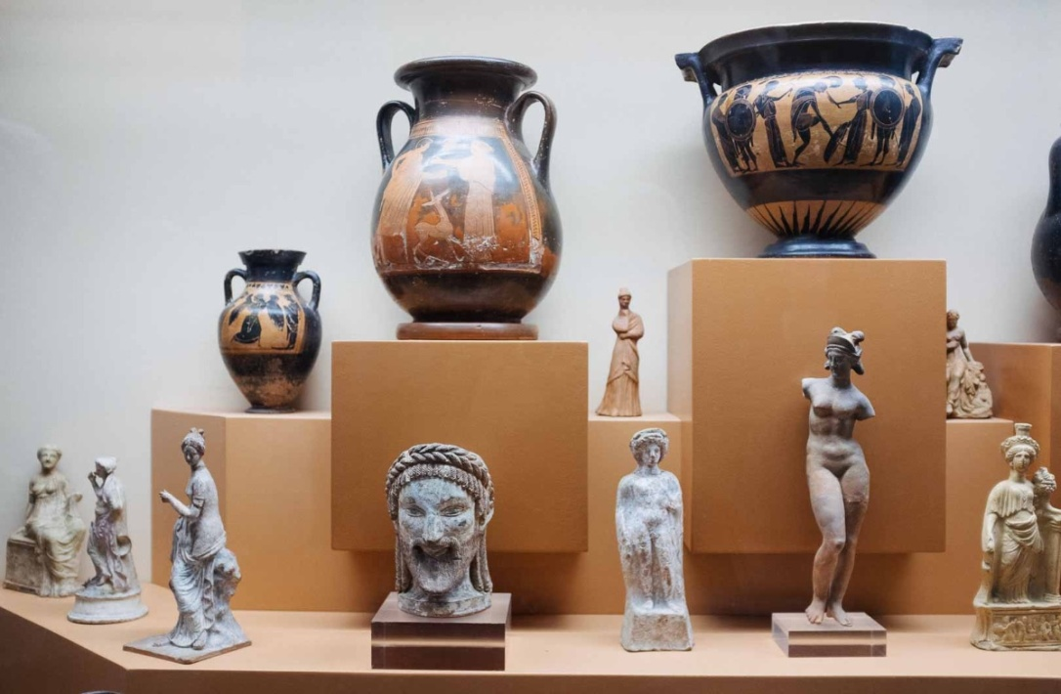
Pearl by the Black Sea
Two thousand years ago, the ancient Greek city of Havana-Istrian was located on the site of modern Odessa. The findings of archaeologists confirm it.

Slide 3
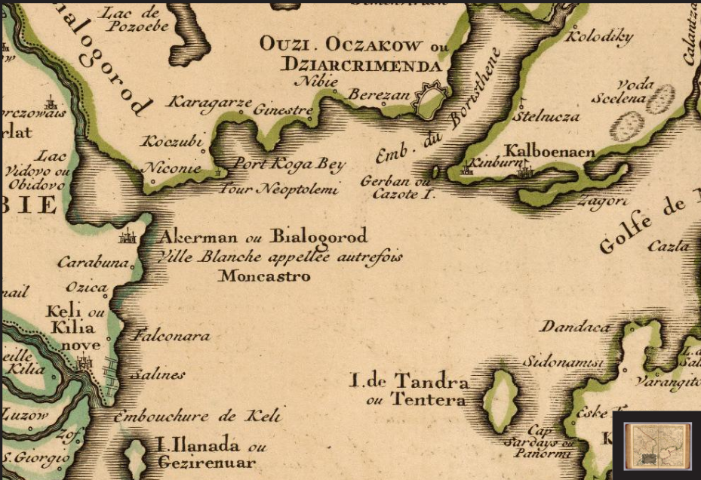
Pearl by the Black Sea
In the XIII-XIV centuries, there was a prosperous port city of Ginestra.
Merchant and warships from Genoa, Venice, and the Mediterranean countries came here.

Slide 4
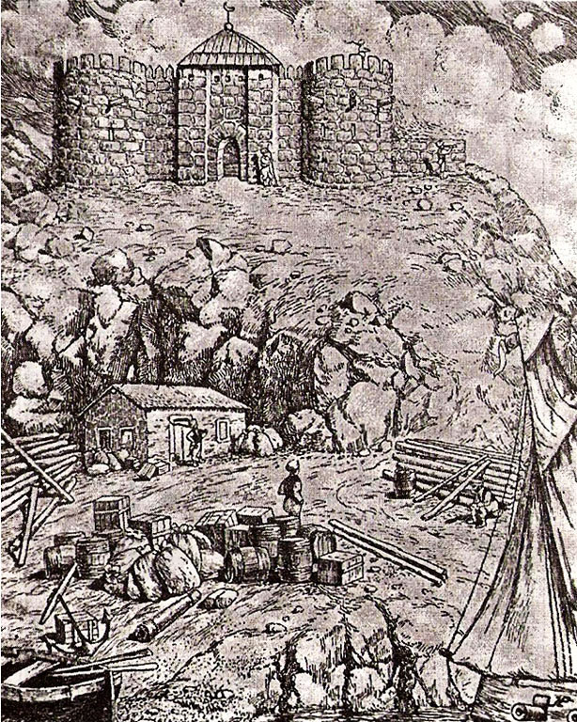
Pearl by the Black Sea
In 1764, the Turkish town of Hadzhibey was located on the site of Odessa. Turks, Tatars, Greeks, Moldovans, and Jews lived here.
The Turks built a fortress here. And they called it Yeni-Dunya-New World. The fort protected the Turkish fleet when it was in the Bay of Hadzhibey.

Slide 5
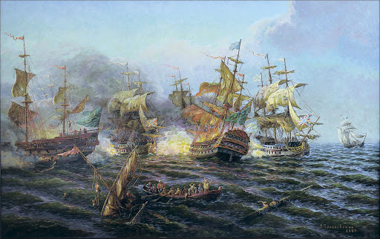
Pearl by the Black Sea
789-1791. Another Russo-Turkish War is taking place.

Slide 6
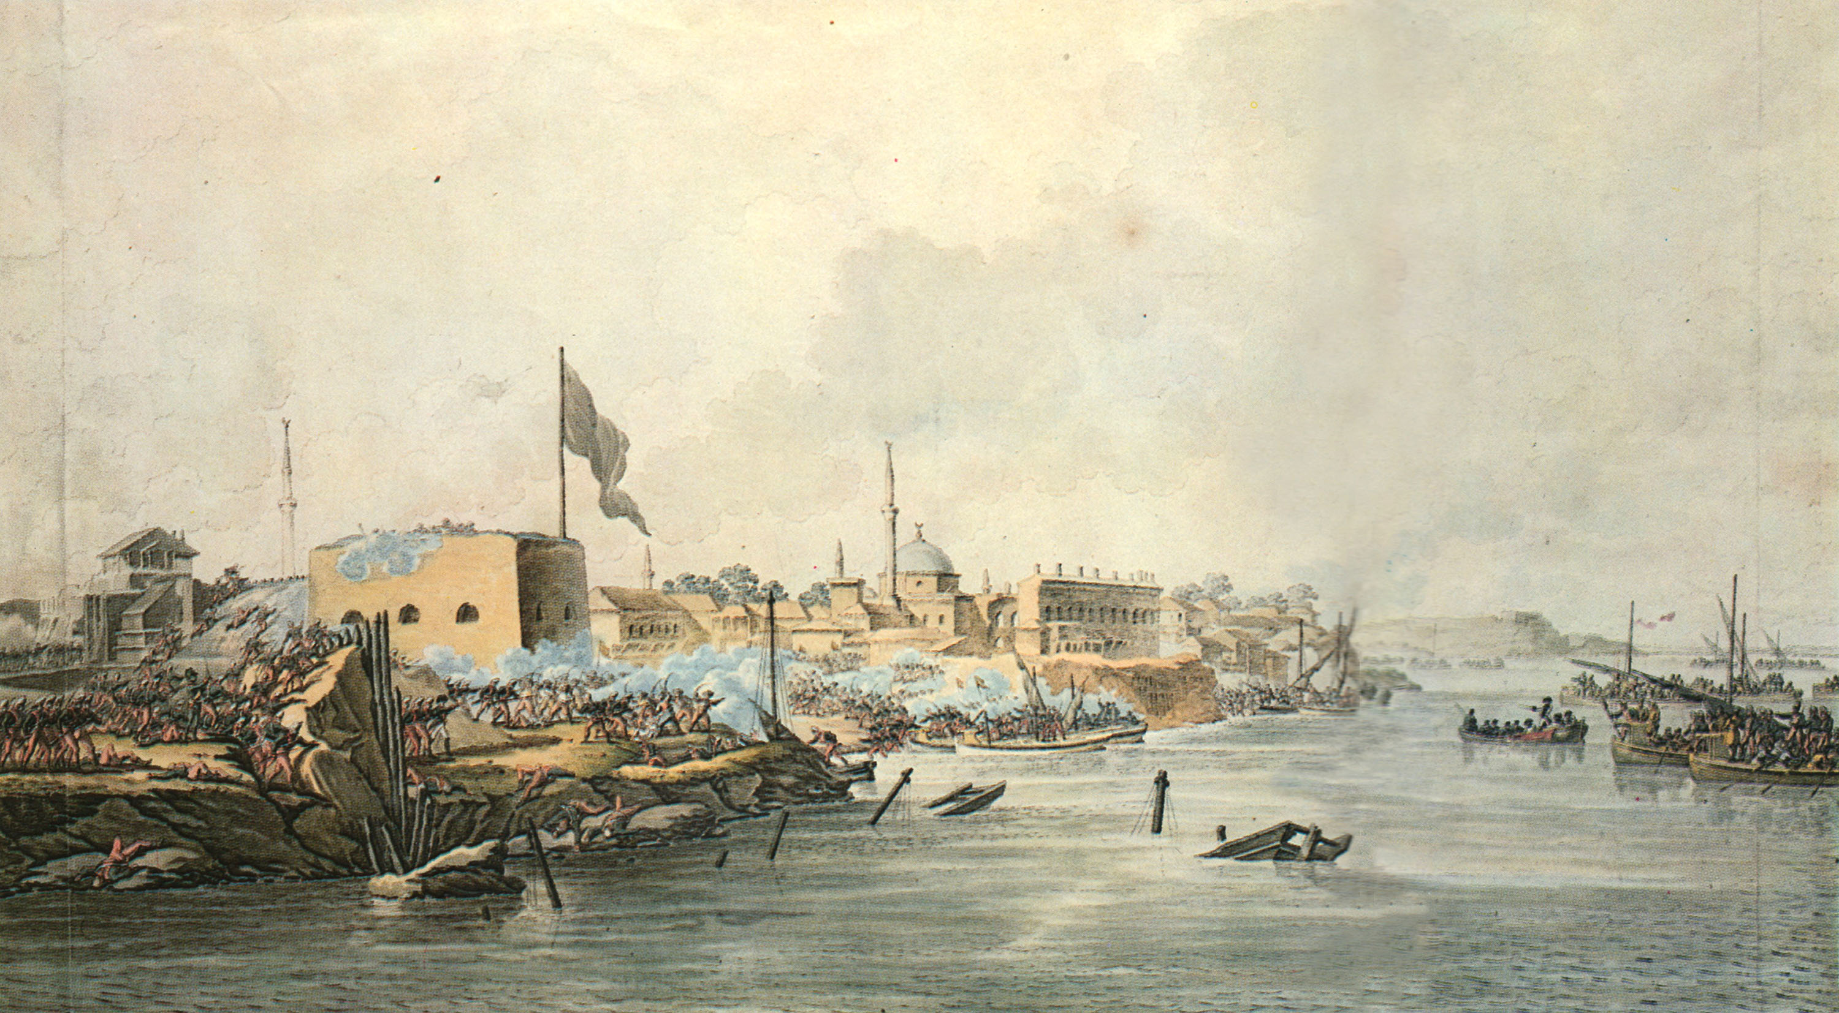
Pearl by the Black Sea
The Russian government is looking for a fleet on the Black Sea coast – a port.

Slide 7
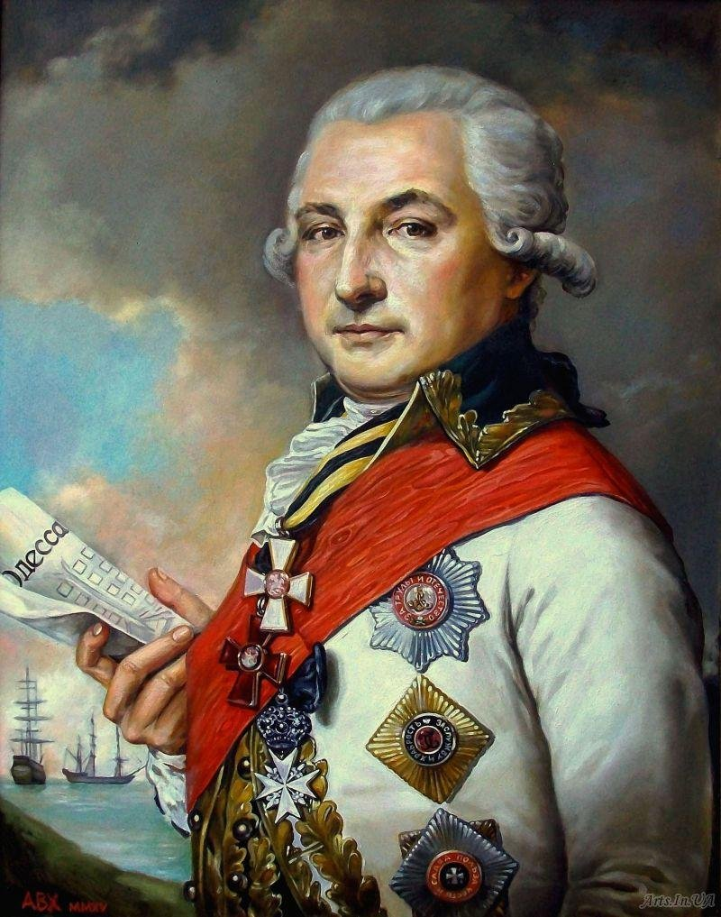
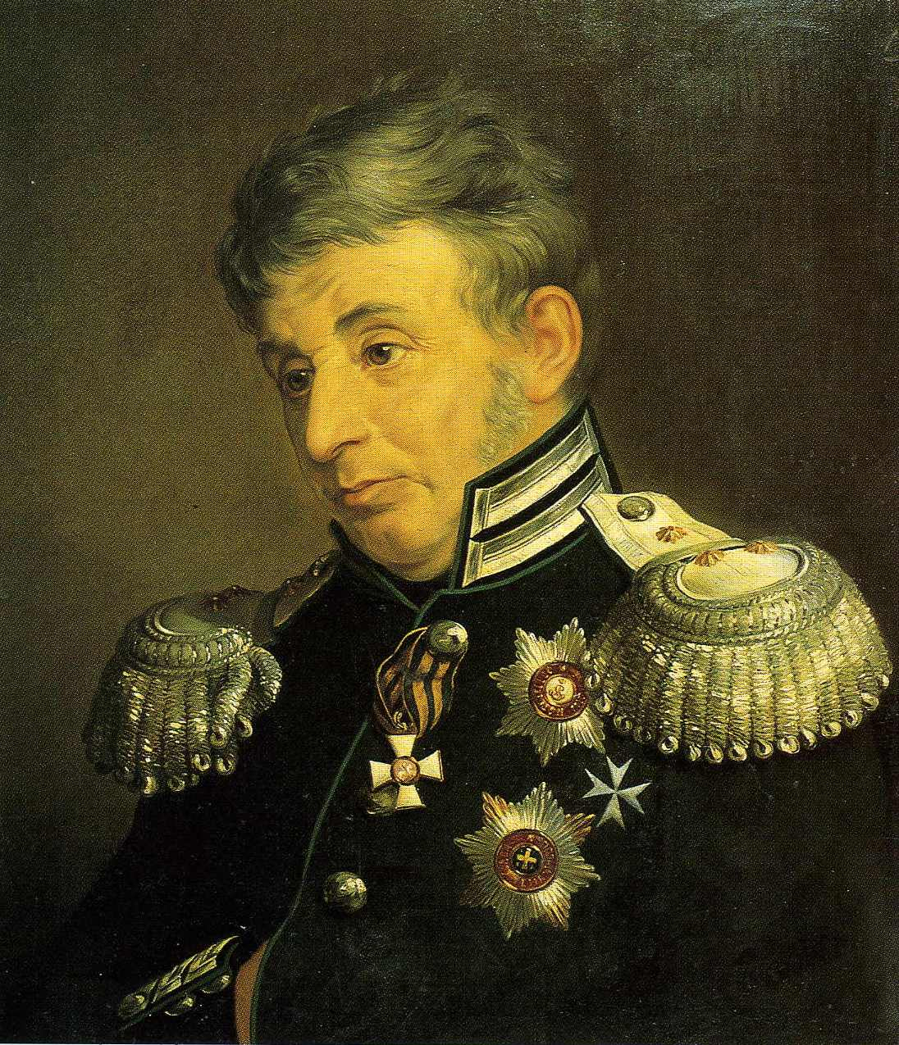
Pearl by the Black Sea
Major General Jose de Ribas and his assistant military engineer Franz de Volan believed that Hadjibey was the best place for a port.
First, navigation here lasts all year round. Secondly, you can trade with Turkey, France, and Italy through the Port of Hadzhibey.

Slide 8
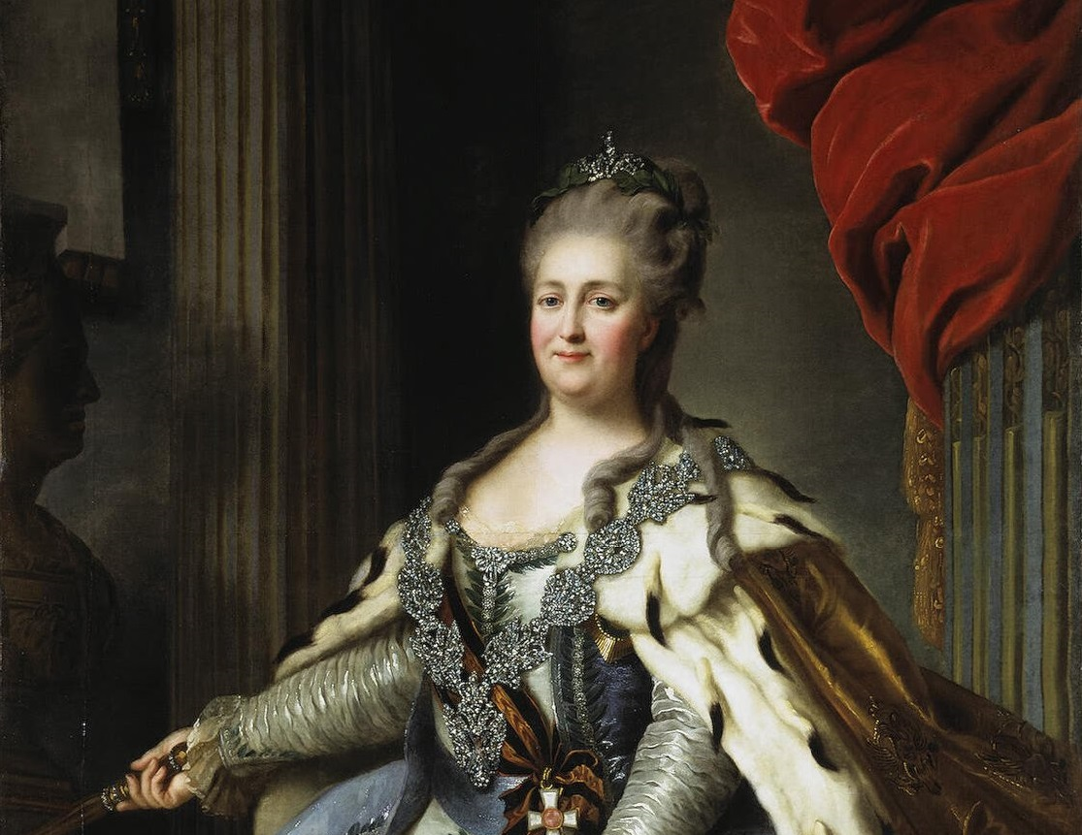
Pearl by the Black Sea
Russian empress Catherine II approves Jose de Ribas's proposal.

Slide 9
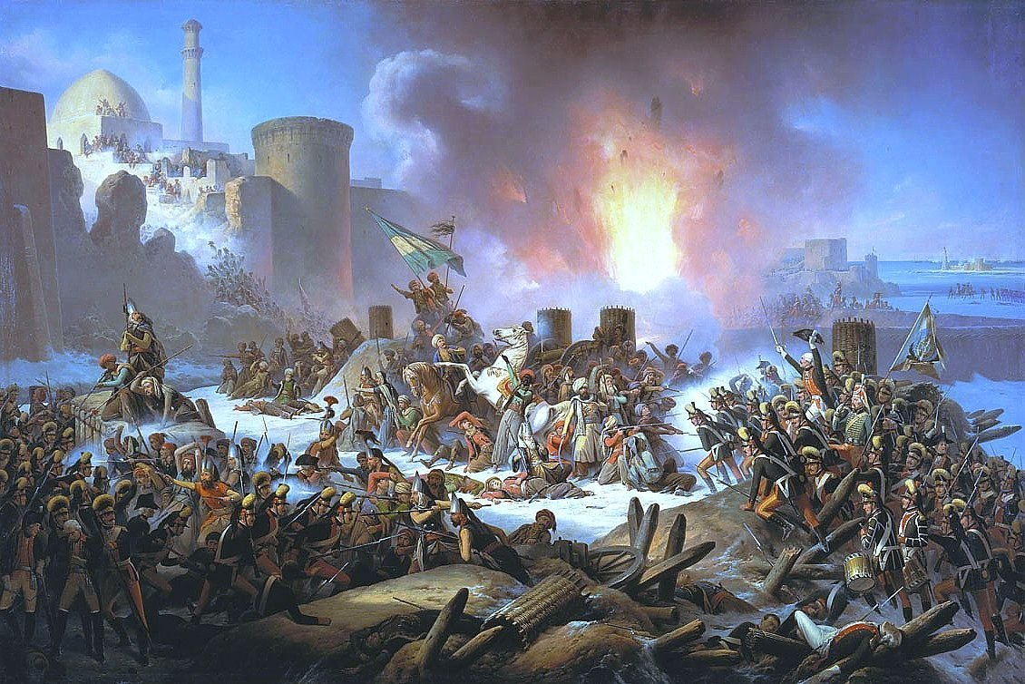
Pearl by the Black Sea
However, on September 14, 1789, the Russian army captured Hadzhibey.

Slide 10
Pearl by the Black Sea
Engineer Franz de Volan drew up a plan for the construction of the city.
Finally, on September 2, 1794, the port was built, which became the birthday of Odessa.

Slide 11
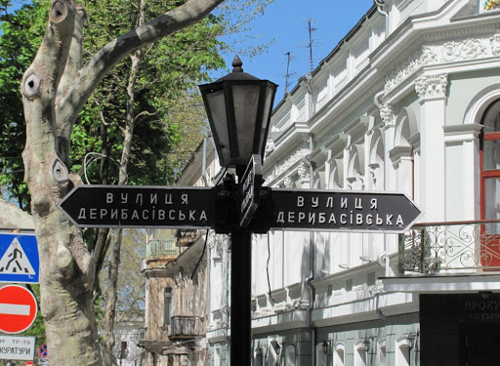
Pearl by the Black Sea
Jose de Ribas – founder of Odessa.
The central street of Odessa was named after him.

Slide 12
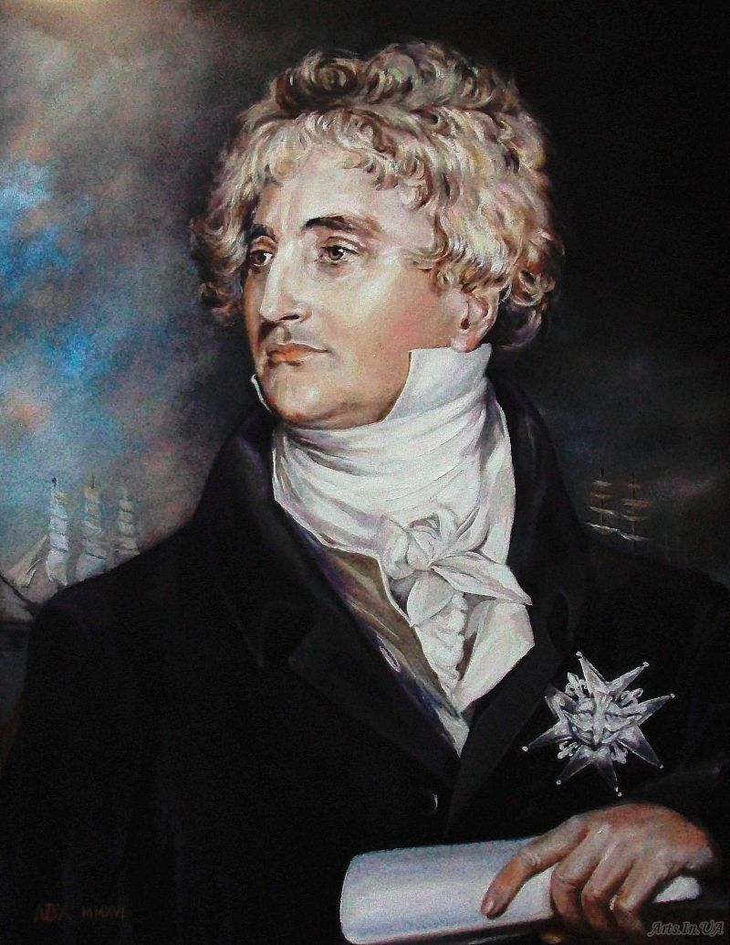
Pearl by the Black Sea
The first mayor of Odessa is Duke de Richelieu.
French aristocrat, very educated, energetic and noble person. During the 11 years of his reign, Odessa became an essential economic, political and cultural center of the South of the Russian Empire. Odessa residents loved and respected de Richelieu. They called him "Our Duke."

Slide 13
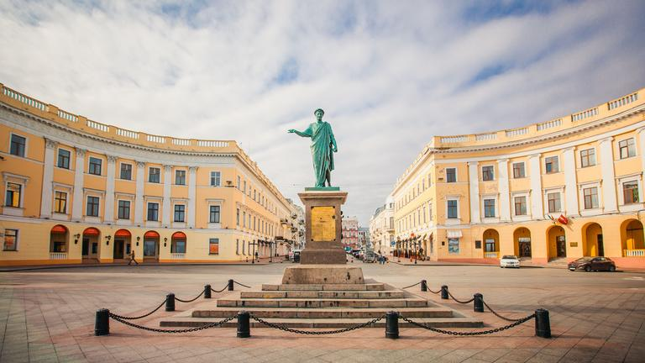
Pearl by the Black Sea
In 1828, a monument to Duke de Richelieu was erected. It is still the hallmark of Odessa today.

Slide 14
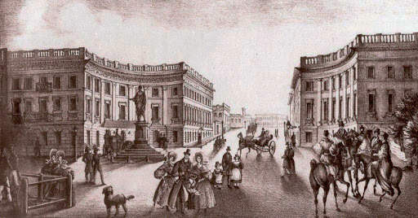
Pearl by the Black Sea
1832. Primorsky Boulevard. Saint Petersburg Hotel!" (right)

Slide 15
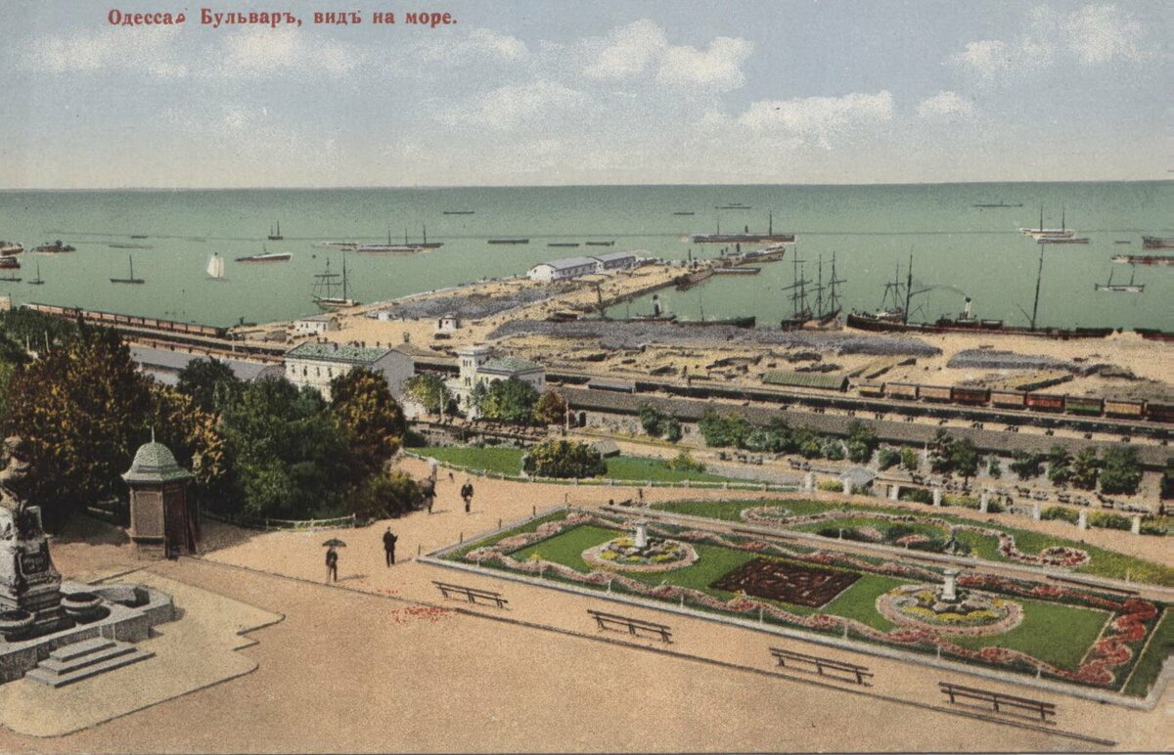
Pearl by the Black Sea
Primorsky Boulevard.
XIX century

Slide 16
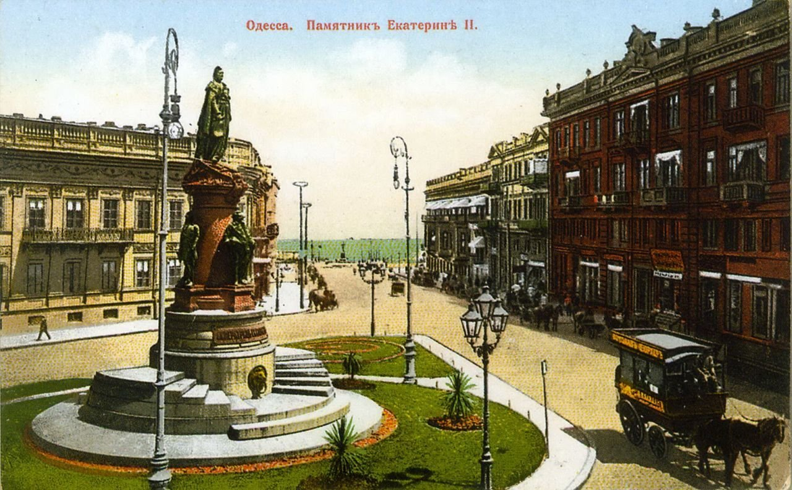
Pearl by the Black Sea
Ekaterininskaya Square. XIX century

Slide 17
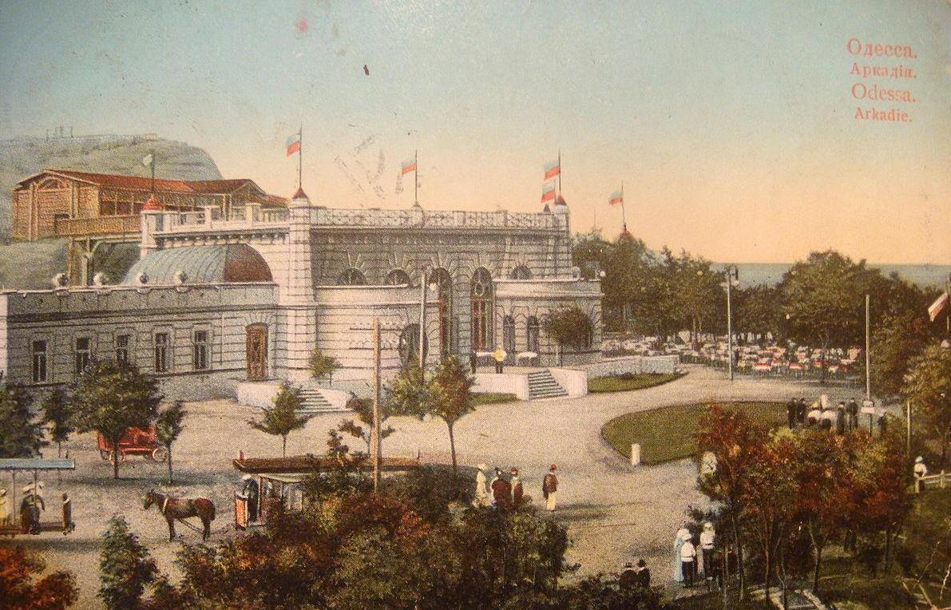
Pearl by the Black Sea
Arcadia. XIX century

Slide 18
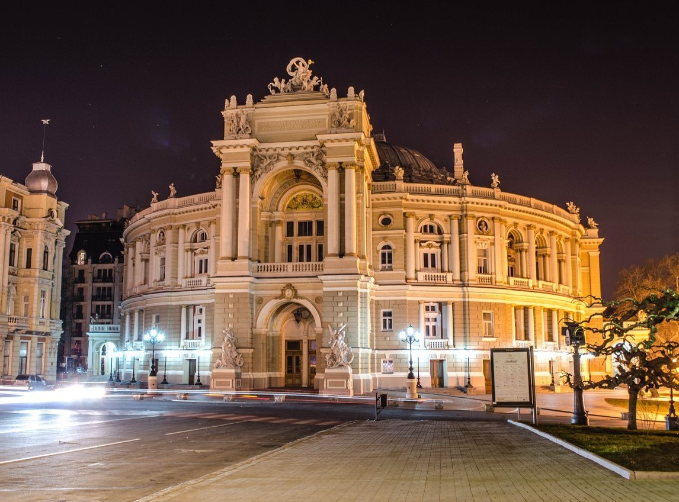
Modern Odessa
Odessa is a city of fantastic architecture.

Slide 19
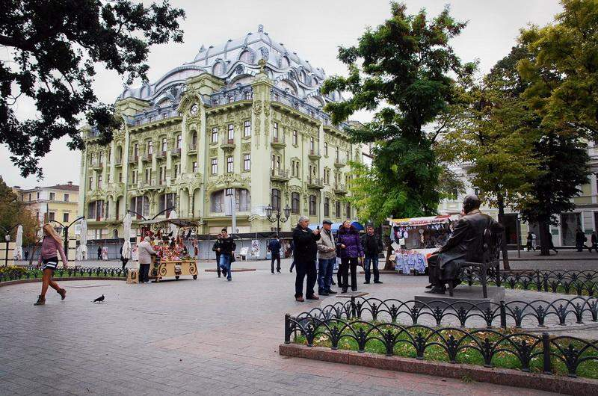
Modern Odessa
Odessa was built on the European model.

Slide 20
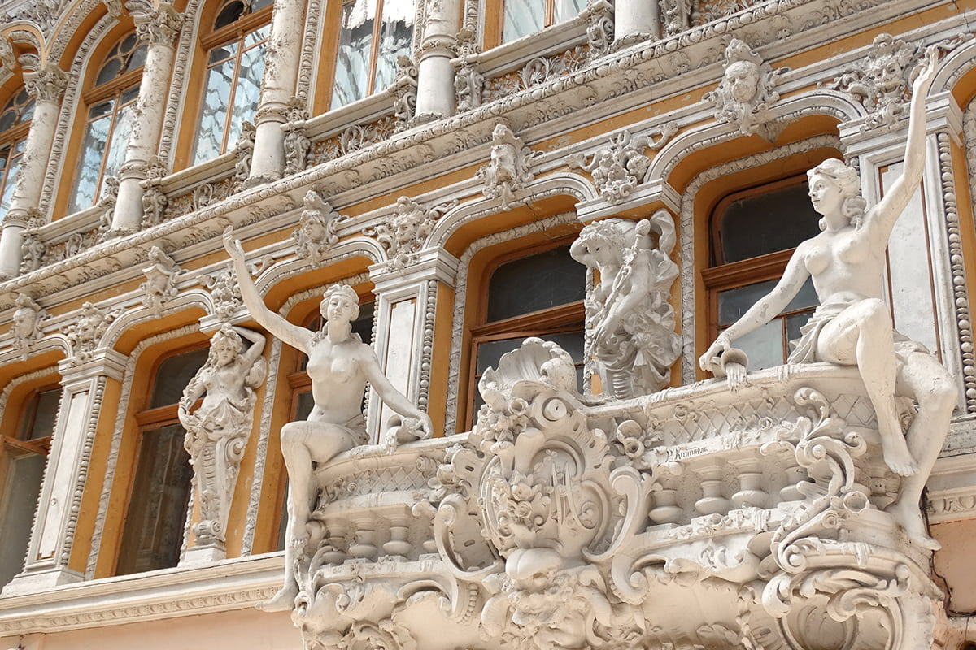
Modern Odessa
Passage. Deribasovskaya Street

Slide 21
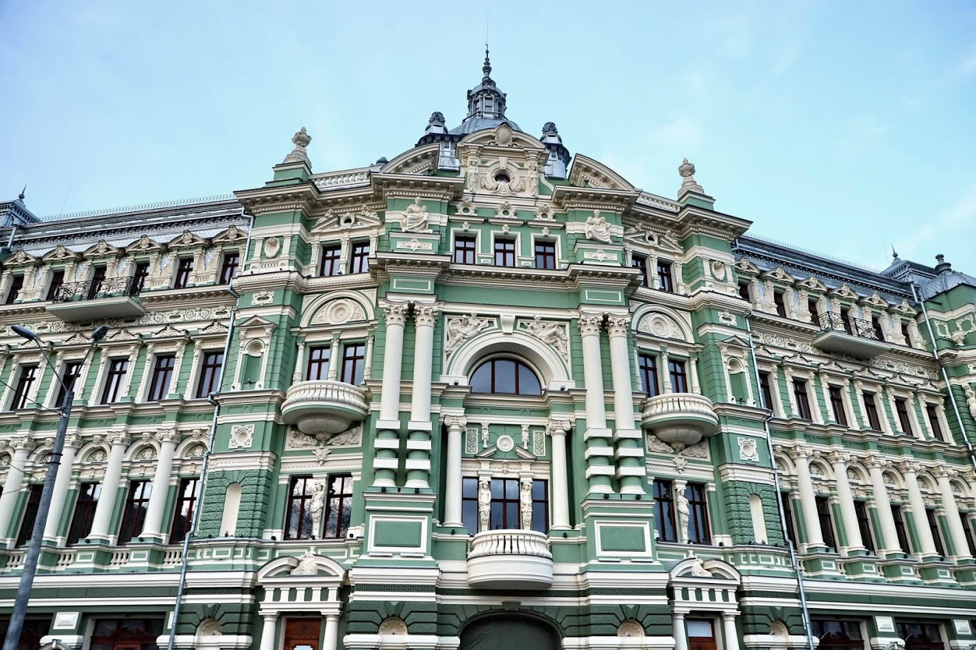
Modern Odessa
A city of fantastic architecture. Rusov's House. Sobornaya square.

Slide 22
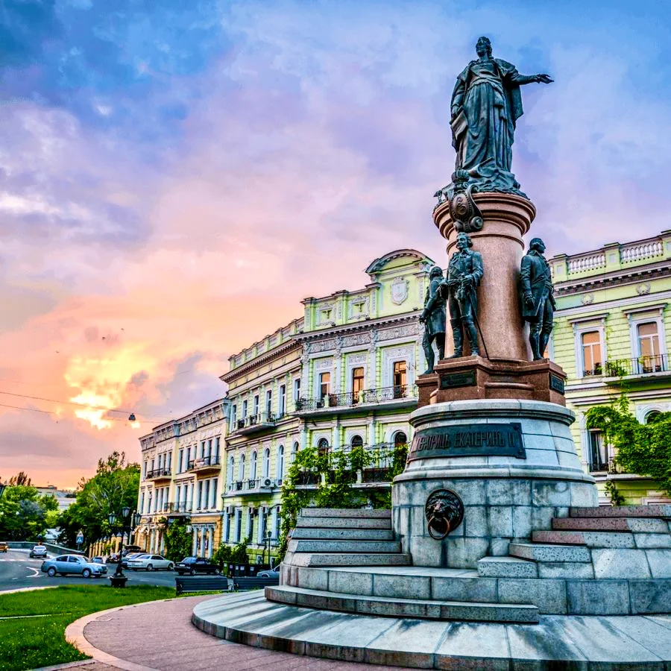
Modern Odessa
A city of fantastic architecture. Ekaterininskaya square

Slide 23
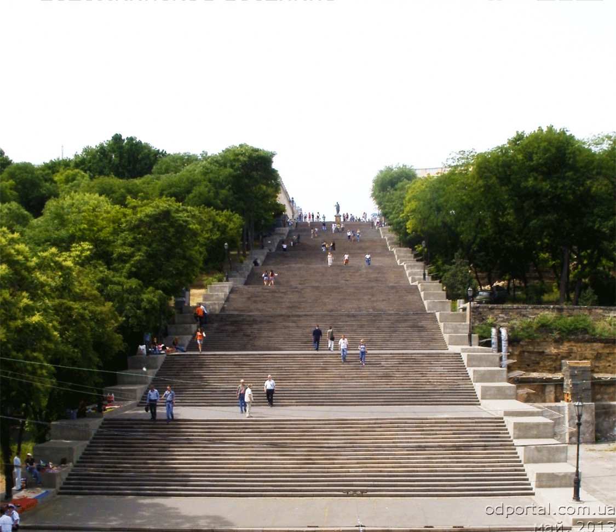
Modern Odessa
Potemkin Stairs

Slide 24
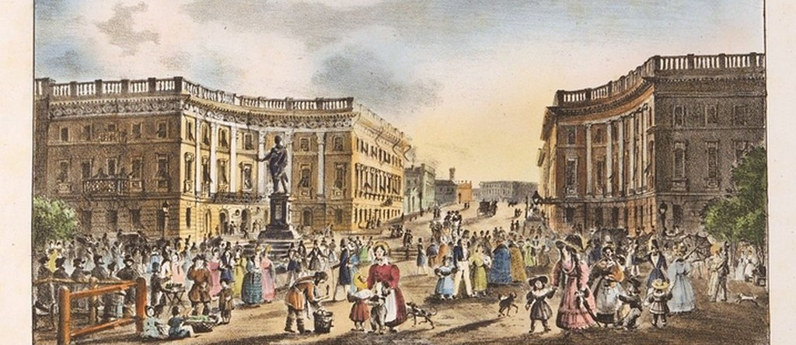
Pearl by the Black Sea
Travelers who visited Odessa in the 19th century recalled: "in Odessa, everything breathed Europe. People of all nations live here: Greeks, French, Jews, Ukrainians, Russians, Armenians, Italians, Germans" "Odessa has always been an international city. From the first days, Odessa was a city of freedom, commerce, cosmopolitanism, and humor.

Slide 25
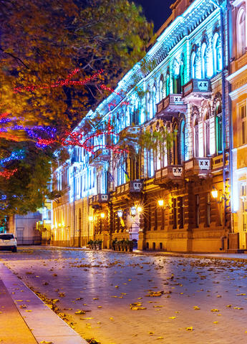
Odessa is an international city
Therefore, there are streets Polskaya, Grecheskaya, Bolgarskaya, Bolshaya and Malaya Arnautskaya, Jewish, French Boulevard, Italian Boulevard, Greek square in Odessa.

Slide 26
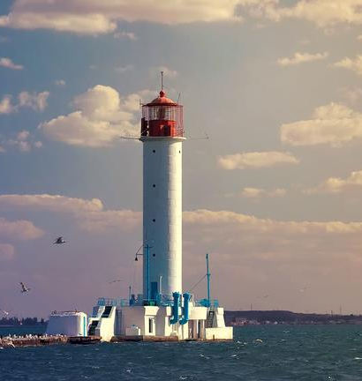
Pearl by the Black Sea
Odesa today is the largest port city, the sea gate of Ukraine, the business, educational and cultural center of the South of Ukraine. The area of Odessa is 236.9 sq. km. The population is more than a million people. In Odessa, there are 20 universities, 30 museums, ten theaters, a film studio.

Slide 27
THANKS
Does anyone have any questions?
Follow Us on Social Media
dec.ipig@opu.ua
opu.ua
fspirki.opu.ua
facebook.com/IPIG.ONPU
Project manager: lebedmy@gmail.com
The presentation was prepared by:
Saveliev A. A., Dean of the Educational Institute of Foreign Citizens Training
Kunitsyn M. V., Deputy Dean of the Educational Institute of Foreign Citizens Training

